Slide 1
Music Genre Classification
Major Project-2 presentation

Slide 2
Internship Details: Organization name:- Linkites Infotech Pvt Ltd Mentor:- Mr. Vivek Gurjar
Student Details:
name:
Aditya manthankar
Enrollment number: en18cs301012

Slide 3
ABOUT THE COMAPNY
Linkites is a notable Web/Mobile Design and development company that has set business mark with innovative design.
Linkites group also achieved excellency in Artificial intelligence and custom enterprise solutions.

Slide 4
Training Details:
Training Duration: 3 Months.
Date of Joining: January 03 2022.
Location: Indore

Slide 5
Machine Learning is said as a subset of artificial intelligence that is mainly concerned with the development of algorithms which allow a computer to learn from the data and past experiences on their own. The term machine learning was first introduced by Arthur Samuel in 1959. We can define it in a summarized way as:
“ Machine learning enables a machine to automatically learn from data, improve performance from experiences, and predict things without being explicitly programmed. “
MACHINE LEARNING

Slide 6
With the help of sample historical data, which is known as training data, machine learning algorithms build a mathematical model that helps in making predictions or decisions without being explicitly programmed. Machine learning brings computer science and statistics together for creating predictive models. Machine learning constructs or uses the algorithms that learn from historical data. The more we will provide the information, the higher will be the performance.
FLOW OF MACHINE LEARNING

Slide 7
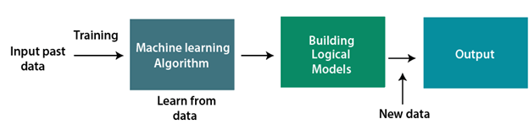
HOW DOES MACHINE LEARNING WORK

Slide 8
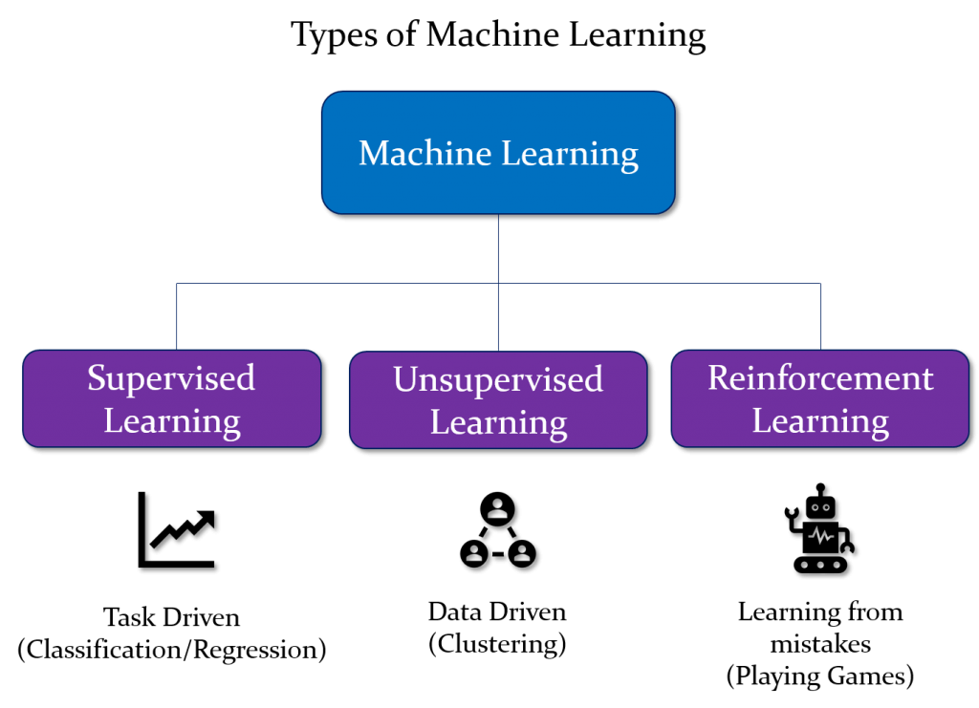
CLASSIFICATION OF MACHINE LEARNING

Slide 9
Supervised learning is a type of machine learning method in which we provide sample labeled data to the machine learning system in order to train it, and on that basis, it predicts the output.
The system creates a model using labeled data to understand the datasets and learn about each data, once the training and processing are done then we test the model by providing a sample data to check whether it is predicting the exact output or not.
The goal of supervised learning is to map input data with the output data. The supervised learning is based on supervision, and it is the same as when a student learns things in the supervision of the teacher. The example of supervised learning is spam filtering.
1) Supervised Learning

Slide 10
2) Unsupervised Learning
Unsupervised learning is a learning method in which a machine learns without any supervision.
The training is provided to the machine with the set of data that has not been labeled, classified, or categorized, and the algorithm needs to act on that data without any supervision. The goal of unsupervised learning is to restructure the input data into new features or a group of objects with similar patterns.

Slide 11
3) Reinforcement Learning
Reinforcement learning is a feedback-based learning method, in which a learning agent gets a reward for each right action and gets a penalty for each wrong action. The agent learns automatically with these feedbacks and improves its performance. In reinforcement learning, the agent interacts with the environment and explores it. The goal of an agent is to get the most reward points, and hence, it improves its performance.
The robotic dog, which automatically learns the movement of his arms, is an example of Reinforcement learning.

Slide 12
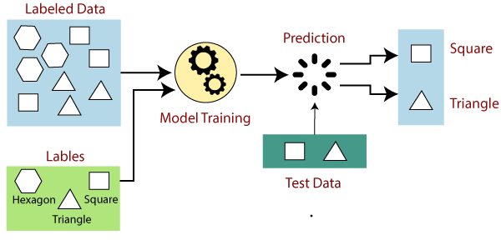
Supervised Machine Learning
In supervised learning, models are trained using labelled dataset, where the model learns about each type of data. Once the training process is completed, the model is tested on the basis of test data (a subset of the training set), and then it predicts the output.
The working of Supervised learning can be easily understood by the below example and diagram:

Slide 13
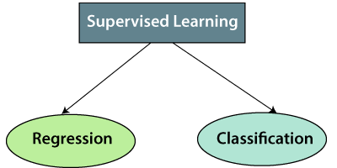
Types of supervised Machine learning Algorithms:

Slide 14
Deep learning can be considered as a subset of machine learning. It is a field that is based on learning and improving on its own by examining computer algorithms. While machine learning uses simpler concepts, deep learning works with artificial neural networks, which are designed to imitate how humans think and learn. THANK YOU
DEEP LEARNING

Slide 15
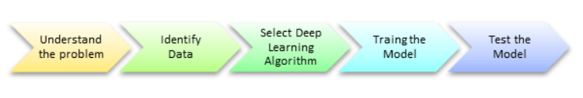
FLOW OF DEEP LEARNING

Slide 16
NEURAL NETWORK
A neural network is a series of algorithms that endeavors to recognize underlying relationships in a set of data through a process that mimics the way the human brain operates.

Slide 17
MUSIC GENRE CLASSIFICATION
Predicting an audio clip’s genre by using MFCC of the input clip with the help of CNN

Slide 18
DATASET
The dataset used for this project is GTZAN Dataset which contains 10 audio clips for every genre of 30 seconds each.
It is downloaded from Kaggle

Slide 19
TECHONOLOGIES USED
The programming language used in the project is Python
Google Colab platform is used for building and training the model
Pycharm IDE is used for feature extraction of training data
Python libraries like Numpy, Librosa, Tensorflow are used

Slide 20
THANK YOU

